Slide 1

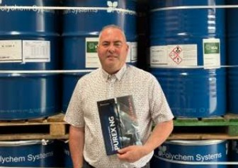

CONTINUING PROFESSIONAL DEVELOPMENT
Polychem Systems
Purex NG OC500 & CC2000
Spray Foam Insulation
Presented by Adrian Sheils
SprayFoam Direct Distribution – Official Irish Distributor
15-minute CPD • Open-cell OC500 • Closed-cell CC2000 • Irish U-value context
sprayfoamdirect.ie | Roscrea Rd, Crinkill, Co. Offaly

Slide 2
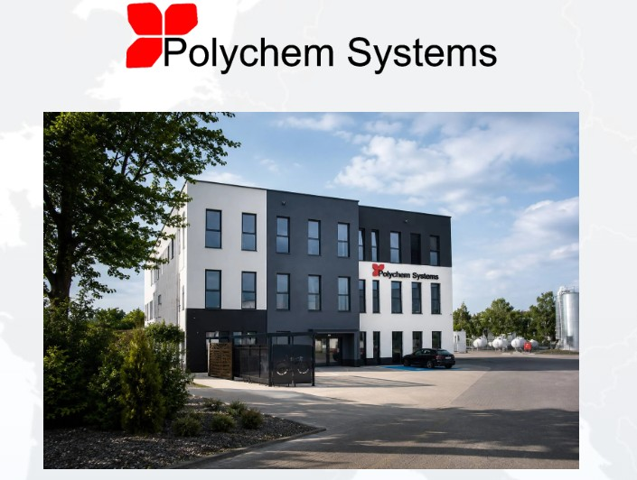
About Your Presenter
Distribution focus
Adrian Sheils
Supplying Purex NG OC500 (open-cell) and Purex CC2000 (closed-cell) across Ireland
Founder & Director
SprayFoam Direct Distribution
Technical support
Product selection, application advice and training support for installers
Official Irish Distributor for
Polychem Systems
Local knowledge
Deep understanding of Irish building types, climate and regulatory requirements
Nationwide supply and technical
support for Purex NG OC500
and Purex CC2000
Contact
087 632 3186 • +353 57 910 6004
info@sprayfoamdirectdistribution.ie
Adrian Sheils | SprayFoam Direct Distribution | Official Irish Distributor – Polychem Systems
2 / 12

Slide 3
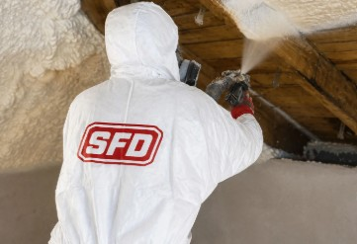


Agenda
01
What is spray polyurethane foam (SPF)?
02
Open-cell vs closed-cell – key differences
03
Purex NG OC500 (open-cell) & Purex CC2000 (closed-cell)
04
Performance data & U-value context
05
Where to specify each product
06
Irish context: NSAI, Building Regulations & SEAI
07
Installation quality & key takeaways
Adrian Sheils | SprayFoam Direct Distribution | Official Irish Distributor – Polychem Systems
3 / 12

Slide 4
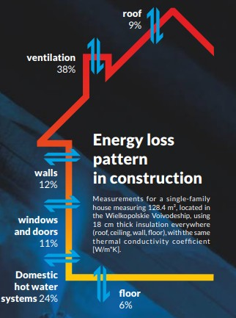
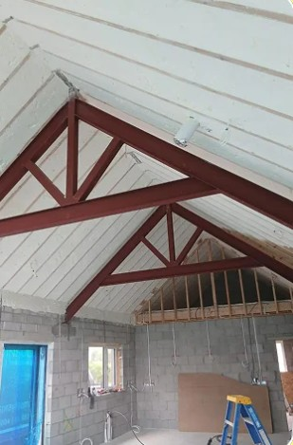
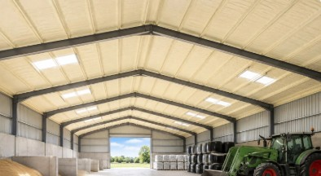
What is Spray Polyurethane Foam?
Two-component system (isocyanate + polyol) mixed at the gun and sprayed under high pressure. Expands in place to form a continuous, seamless insulation layer that also acts as an air barrier.
Low thermal conductivity. Fills irregular cavities completely and helps achieve target U-values without thermal bridges.
Continuous seal reduces uncontrolled air leakage – a major source of heat loss in Irish dwellings.
Thermal Insulation
Air Barrier
Versatile Application
Attics, walls, floors, roofs, industrial & agricultural buildings. Adheres to timber, masonry, metal, concrete.
Adrian Sheils | SprayFoam Direct Distribution | Official Irish Distributor – Polychem Systems
4 / 12

Slide 5
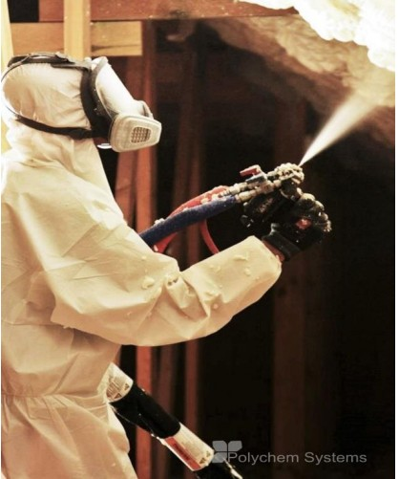

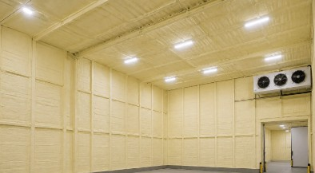
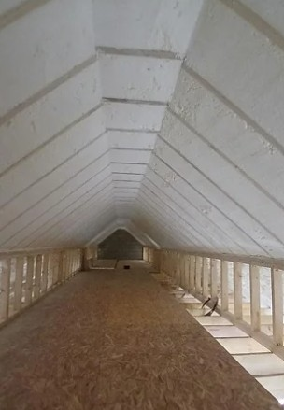
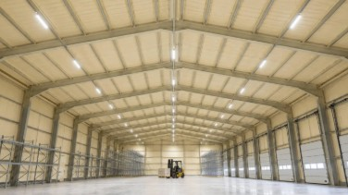
Adrian Sheils | SprayFoam Direct Distribution | Official Irish Distributor – Polychem Systems
3 / 12

Slide 6
Open-Cell vs Closed-Cell
OPEN-CELL – Purex NG OC500
CLOSED-CELL – Purex CC2000
▸ Density: typically 8–12 kg/m³
▸ Density: typically 30–40 kg/m³
▸ λ ≈ 0.036–0.038 W/m·K
▸ λ ≈ 0.022–0.025 W/m·K
▸ Soft, flexible, vapour-permeable
▸ Rigid, high compressive strength
▸ Excellent acoustic absorption
▸ Very low water absorption
▸ Expands ~100× liquid volume
▸ Acts as vapour retarder
▸ Best for interiors: attics, walls, ceilings
▸ Suitable for exterior & below-grade
▸ Lower installed cost per m²
▸ Higher performance per mm of thickness
▸ Not for continuous water exposure
▸ Adds structural racking strength
Adrian Sheils | SprayFoam Direct Distribution | Official Irish Distributor – Polychem Systems
5 / 12

Slide 7
The Two Products We Supply
Purex NG OC500
Purex CC2000
Open-cell spray foam
Closed-cell spray foam
• Low-density open-cell structure
• Medium-density closed-cell structure
• Thermal & acoustic insulation
• High thermal performance per mm
• Internal applications – attics, walls, ceilings
• Internal & external applications
• Vapour-permeable
• Very low water absorption
• Excellent air sealing when applied correctly
• Vapour retarder + structural contribution
• CE marked to EN 14315-1
• CE marked to EN 14315-1
Adrian Sheils | SprayFoam Direct Distribution | Official Irish Distributor – Polychem Systems
6 / 12

Slide 8
Performance & U-Value Context
In Ireland we design and specify using U-values (W/m²K). The lower the U-value, the better the thermal performance of the building element.
Property | Purex NG OC500 | Purex CC2000
Type | Open-cell | Closed-cell
Typical density | 8–12 kg/m³ | 30–40 kg/m³
λ (W/m·K) | ≈ 0.036–0.038 | ≈ 0.022–0.025
Structure | Soft / flexible | Rigid
Vapour behaviour | Vapour-permeable | Vapour retarder
Water absorption | Higher | Very low
Primary use | Internal attics & walls | Agri and commercial
Adrian Sheils | SprayFoam Direct Distribution | Official Irish Distributor – Polychem Systems
7 / 12

Slide 9
Where to Specify Each Product
Prefer Purex NG OC500
Prefer Purex CC2000
• Attics & loft conversions (internal)
• Flat roofs & external roof decks
• Internal walls & partitions
• Foundations & below-grade walls
• Ceilings & suspended floors
• Industrial / agricultural buildings
• Where acoustic performance matters
• Cold stores & high-moisture areas
• Projects prioritising vapour openness
• Where high compressive strength needed
• Budget-sensitive large-volume fills
• Limited cavity depth (better U-value per mm)
Adrian Sheils | SprayFoam Direct Distribution | Official Irish Distributor – Polychem Systems
8 / 12

Slide 10
Irish Regulatory Context
NSAI Certification
For SEAI grant eligibility and proven suitability under Irish site conditions, the specific foam system should hold a current NSAI Certificate confirming compliance with Building Regulations.
Building Regulations
Part L (Conservation of Fuel & Energy) sets elemental U-value targets. Part F (Ventilation) is critical when airtightness is improved. Part B (Fire) covers reaction-to-fire and thermal/ignition barriers.
SEAI Grants
Attic insulation and other measures remain grant-aided when installed by registered contractors using products that meet the scheme’s technical requirements (typically NSAI Certification & correct detailing).
Best Practice
Follow the NSAI Certificate scope: AVCL where required, residual ventilation, thickness limits per pass, and installer competence. Incorrect detailing is the main source of reported issues.
Adrian Sheils | SprayFoam Direct Distribution | Official Irish Distributor – Polychem Systems
9 / 12

Slide 11
Key Performance Benefits
01
02
03
Seamless air seal
Target U-values
Moisture control options
Eliminates gaps and thermal bridging common with batts or boards – supports better U-values
Closed-cell CC2000 delivers strong thermal performance in limited depth
CC2000 resists water; OC500 allows greater drying potential
04
05
06
Acoustic performance
Structural contribution
Long-term stability
OC500 open-cell systems provide excellent sound absorption
CC2000 can increase racking strength of framed assemblies
Declared parameter stability when correctly installed and detailed
Adrian Sheils | SprayFoam Direct Distribution | Official Irish Distributor – Polychem Systems
10 / 12

Slide 12
Installation & Quality Essentials
Trained applicators only
High-pressure equipment, correct temperatures, ratio control and PPE are mandatory. Quality depends heavily on installer skill.
Layer thickness & curing
Respect maximum pass thickness and inter-pass times. Over-application can cause shrinkage or incomplete curing.
Substrate preparation
Clean, dry, suitable temperature. Excellent adhesion is a strength – but only on properly prepared surfaces.
Fire & thermal barriers
Where required by Building Regulations, install approved thermal/ignition barriers (e.g. plasterboard) over the foam.
Ventilation & AVCL
Follow the product’s Certification or technical guidance for vapour control layers and residual ventilation needs.
Documentation
Record product batch, thickness achieved, installer details and any Certificate of Compliance for BER / handover.
Adrian Sheils | SprayFoam Direct Distribution | Official Irish Distributor – Polychem Systems
11 / 12

Slide 13
Key Takeaways
1.
Purex NG OC500 (open-cell): lower density, vapour-open, strong acoustic performance – ideal for internal attics and walls.
2.
Purex CC2000 (closed-cell): higher performance per mm, moisture resistance, structural contribution – preferred for Agri,commercial and demanding environments.
3.
Both systems are CE-marked and supplied in Ireland by SprayFoam Direct Distribution.
4.
Specify systems that carry NSAI Certification where grant funding or formal compliance evidence is required. Design to target U-values.
5.
Correct installation and detailing determine long-term performance far more than the product alone.
Questions? Contact Adrian Sheils • 087 632 3186 • info@sprayfoamdirectdistribution.ie
SprayFoam Direct Distribution | Roscrea Rd, Crinkill, Co. Offaly | Official Irish Distributor – Polychem Systems
www.sprayfoams.ie

